Slide 1
Capital Project Overview
American Rescue Plan Act – State and Local Fiscal Recovery Funds
November 18th, 2022
Governor’s Finance Office
Notes:
Welcome to todays Capital Project Overview webinar. I am Bart Ermeling, the Program Director for IEM. As most of you know, IEM has been hired by the State of Nevada to provide consultation services for all of the State's ARPA projects. I will be assisted by Eliza VanOverschelde and Gary Moore from IEM, as well as Brenda Berry and Casey Van Patten from the Governor's Finance Office.
The Governor’s Finance Office and IEM developed this Capital Project PowerPoint to assist subrecipients and state agencies in understanding the unique requirements for capital projects when using State and Local Fiscal Recovery Funds. Please note this is not an exhaustive list of requirements. It is a reference guide to assist our partners with steps necessary to start and manage a capital project.
A few housekeeping items: At the end of this presentation, time permitting, we will have a Q and A session. Please feel free to put any questions into the chat. Contact information is on the last slide of this presentation. If questions arise in the coming weeks and months, please reach out. The GFO will respond and add the information to a FAQ document to be posted on their website. Additionally, if federal requirements update or change, notification will be sent out to the state cognizant agency, who will then disseminate it to their subrecipients.
This presentation is being recorded and the link will be sent to all attendees within the next few weeks. A copy of this PowerPoint was emailed to attendees earlier this morning. Let's get started!

Slide 2
Overview
Period of Performance
Federal Guidance
Reporting Guidance
Procurement
Affirmative Steps
Procurement and CFR
Bonds
Conflicts of Interest
Competitive Bidding
Best Practices
Prevailing Wage
Construction Timelines and Checklists
Local Guidance
References
Notes:
This is the general overview of todays briefing. We will explore each of these topics throughout the presentation. Again, please write down your questions or post them in the chat and we will answer all of them at the end of the presentation.

Slide 3
Acronyms/Definitions
ARPA – American Rescue Plan Act
Congressional act that established many streams of funding for pandemic recovery
SLFRF – State and Local Fiscal Recovery Funds
The State's main stream of revenue under ARPA
GFO – Governor's Finance Office
State office overseeing SLFRF funds
CFR – Code of Federal Regulations
Rules established by the Federal Government
Notes:
Here are a few acronyms that we will use throughout the presentation.

Slide 4
Period of Performance
Under the SLFRF program, funds must be used for costs incurred on or after March 3, 2021. Furthermore, funds must be obligated by December 31, 2024, and expended by December 31, 2026. This time period, during which recipients can expend SLFRF funds, is the “period of performance”.
Notes:
The period of performance is critical to understand. All funds must be obligated by December 31st, 2024. That means that there must be a contract, purchase order, subgrant, etc in place utilizing all awarded funds. Work does not have to complete as of December 31st, 2024, so long as a contract exists for said work. However, all work does need to be complete and funds expended by December 31st, 2026.
Specifically for state agencies, in order to be considered obligated, the funds must be sub-granted out to an outside agency, contracted, or a purchase order must be completed and submitted to a vendor by December 31st, 2024. Because the Federal government does not differentiate between state agencies, they do not consider the funds obligated simply because the GFO sub-granted funds to the state agency. We are sending questions to the Treasury to confirm this understanding and will advise of any response we receive. Any specific questions regarding this can be emailed to Brenda Berry or Casey Van Patten on the ARPA team.

Slide 5
Capital Projects
Projects must comply with all applicable federal laws and regulations, and with all requirements for state, local, and Tribal laws and ordinances to the extent that such requirements do not conflict with federal laws.
Projects should be carried out in ways that produce high-quality infrastructure, avert disruptive and costly delays, and promote efficiency.
Notes:
Capital projects by definition help maintain or improve a city/county/state asset, also know as infrastructure. This can be done with new construction, expansion, renovation or by replacing an existing facility. All of the projects we will be discussing today meet these requirements, in doing so they must be high quality, have no delays and be ran efficiently. Also all of these projects must be in compliance with all applicable federal, state, and local laws as well as tribal laws if applicable.

Slide 6
Capital Projects & The Final Rule
The Final Rule, revised as of April 2022, implements the Coronavirus State and Local Fiscal Recovery Fund (SLFRF) established under the American Rescue Plan Act (ARPA) (see pages 190 – 208 for specifics to Capital Projects).
Overview of the Final Rule - provides a summary of the final rule and is intended to be a brief, simplified user guide (see pages 30 – 31 for specifics to Capital Projects).
The CSLFRF Final Rule FAQ contains answers to frequently asked questions regarding Coronavirus State and Local Fiscal Recovery Funds (Ctrl + F to search words related to questions).
Notes:
Since ARPA are federal funds, there are very specific rules for its use. All of these projects must follow the Final Rule. Over 400 pages of very dry reading. Capital projects can be found between pages 190-208 specifically but there is a lot of great information throughout the document if you would like to learn more. I suggest you focus on the Overview of the Final Rule, pages 30 and 31. We have provided the links to all of these documents in this presentation and will have a final slide that has the URLs. We strongly suggest looking through the FAQ's of the Final Rule. There is no real organization to these questions so a simple Control F search will help guide you to what you are looking for.

Slide 7
Subrecipient Reporting
Recipients are required to report financial and programmatic information to their state cognizant agency on a quarterly basis, by the 5th of the month following the end of a quarter, as the state agency must report to the GFO by the 10th of the month, following the quarter.
January 1st to March 31st – Due to State Cognizant Agency April 5th
April 30th to June 30th – Due to State Cognizant Agency July 5th
July 1st to September 30th – Due to State Cognizant Agency October 5th
October 1st to December 31st – Due to State Cognizant Agency January 5th
Required reporting includes the amount expended for the quarter being reported and the number of individuals, households, etc. served.
Notes:
Recipients are required to submit reporting information to their state cognizant agency on a quarterly basis. The state cognizant agency is the agency that is overseeing the project, so in the case of the Childcare Expansion, that would be Division of Welfare and Supportive Services, Child Care and Development Program.
Information should be submitted by the subrecipient no later than the 5th of the month following the end of a quarter. The state agency will then need to supply the information to the GFO no later than the 10th of the month following the end of a quarter.
Reporting will consist of the amount expended that quarter and the number of individuals or households served.
Each of you cognizant agencies will provide the subrecipient with a reporting template.

Slide 8
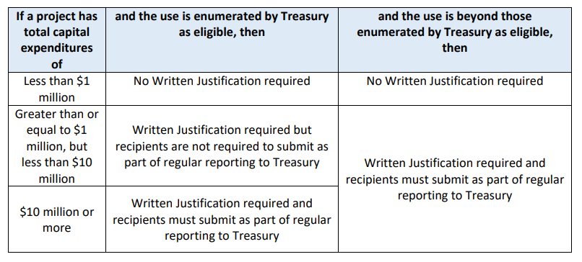
Reporting for Projects Over $1M
For capital expenditures equal to or greater than $1 million, recipients must complete and meet the requirements of a written justification. See Page 30 of the SLFRF Overview for what a written justification includes.
See table below for Treasury's written justification reporting requirements.
A subrecipient's state cognizant agency will reach out for this written justification.
Notes:
For projects that are over $1 million, additional reporting in the means of a written justification might also be needed.
The state cognizant agency will reach out if this justification is needed.

Slide 9
Procurement Policy Requirements
From the SLFRF Compliance and Reporting Guidance, page 10.
Recipients must have and use documented procurement procedures that are consistent with the standards outlined in 2 CFR 200.317 through 2 CFR 200.327.
The Uniform Guidance, pursuant to 2 CFR 180, requires an infrastructure for competitive bidding and contractor oversight, including maintaining written standards of conduct and prohibitions on dealing with suspended or debarred parties.
Notes:
A procurement policy is the rules and language that guides an agency when making contracting and purchasing decisions.
The US Treasury, who oversees the ARPA funds, requires all recipients to have and use a written procurement policy that is consistent with 2 CFR 200.317 through 2 CFR 200.327.
They also require the use of competitive bidding, have oversight of contractors, and ensure that all contractors and subcontractors are not suspended or debarred.
We will discuss these topics in more detail later in this presentation.

Slide 10
Affirmative Steps
The non-Federal entity must take all necessary affirmative steps to assure that the following are used, when possible:
Small Businesses
Minority-Owned Businesses
Women-Owned Businesses
Labor surplus area firms
Grant recipients should also require their contractors to take affirmative steps to subcontract with small businesses, minority and women owned firms, and labor surplus area firms.
Notes:
Entities must take affirmative steps to, when possible, contract with small business, minority or women owned businesses or labor surplus area firms. A Labor Surplus Area (LSA) is a civil jurisdiction that has a civilian average annual unemployment rate during the previous two calendar years of 20% or more above the average annual civilian unemployment rate for all states (including Puerto Rico) during the same 24-month reference period. The only companies this applies to for FY2023 are businesses registered in Clark County, NV, Las Vegas, NV, and North Las Vegas, NV. I would highly recommend attempting to hire firms like these and would suggest requiring the reporting of using protected populations throughout the course of this award.
The Treasury also encourages giving preference to local hires.

Slide 11
2 CFR 200.317-327 Overview
200.317 - Subrecipients of a State must follow the standards set in 200.318 through 200.327
200.318 - Entities:
Must have documented procurement procedures.
Must maintain oversight of contractors to ensure they are meeting the terms of the contract.
Must have written standards regarding conflicts of interest.
Must avoid purchasing duplicate or unnecessary items.
Encouraged to enter into inter-entity agreements to procure common or shared goods or services or used Federal surplus property.
Must only enter into contracts with responsible contractors and consider matters such as contractor integrity, past performance, and financial resources.
Must maintain records regarding procurement, contractor selection or rejection and basis of selection.
May use a time-and-materials contract only after determination that no other contract is suitable and this type of contract must not include a positive profit incentive for the contractor.
Must alone be responsible for the settlement of all contractual and administrative issues arising out of procurements, including protests, disputes, and claims.
Notes:
As mentioned earlier, SLFRF requires that subrecipients have and use a written procurement policy that is consistent with 2 CFR 200.317 through 2 CFR 200.327. This slide and the next provide an overview of the contents of those regulations.
200.318 details required procurement practices. Some of the main requirements are:
Entities must have a documented procurement policy, as well as a policy regarding conflicts of interest.
Entities must maintain oversight of contractors to ensure they are meeting the terms of said contract. And only responsible contractors, based on past performance, integrity, and financial resources, should be used.
In regards to purchasing, entities must avoid purchasing duplicate or unnecessary items.

Slide 12
2 CFR 200.317-327 Overview, contd.
200.319 - Entities must use open competitive bidding. See Competitive Bidding Requirements slides for more information.
200.320 - Entities must have and use documented procurement procedures for micro-purchases, formal procurement, sealed bidding, how proposals will be handled, and noncompetitive procurement.
200.321 - Entities must take all necessary affirmative steps to assure that minority businesses, women's business enterprises, and labor surplus area firms are used when possible.
200.322 - Entities must provide preference of goods produced in the United States.
200.323 - Not relevant to grantees.
200.324 - Entities must perform a cost or price analysis (including making independent estimates before receiving bids) and negotiate profit as a separate element of the price. And a cost plus a percentage of cost and percentage of construction cost methods of contracting must not be used.
200.325 - Entities must make available documents relating to procurement and bidding to the State or Federal government upon request.
200.326 - Bidders must meet the following bonding requirements:
Bid guarantee from each bidder equivalent to five percent of the bid price.
A performance bond (provided by the contractor) for 100 percent of the contract price.
A payment bond (provided by the contractor) for 100 percent of the contract price.
200.327 - Contracts must contain applicable provisions as described in appendix II (Davis-Bacon is not applicable unless over $10 million).
Notes:
Continuing on, 200.319 maintains that entities must use open, competitive bidding.
200.320 details the allowable methods of procurement, including formal procurement standards for sealed bids and proposals. We will go into more detail regarding procurement and competitive bids a little later in this presentation.
200.321 states the need to use minority and women owned businesses, small business, and labor surplus area firms when possible.
200.322 states that preference must be given to products made in America.
200.323 is not relevant to the Childcare Expansion funding.
200.324 states that entities must perform a cost analysis prior to receiving bids on a project. When negotiating, profit must be negotiated separately from the price of the project. Also entities cannot enter into contracts that are based on a cost plus a percentage of construction cost. This ties back into the point that profit must be negotiated separately and not based simply on a percentage of total cost.
200.325 states that documentation about procurement and bidding must be maintained and made available to state or federal agencies upon request.
200.326 discusses the bonding requirements that we will discuss in more detail next.
200.327 states additional provisions that must be maintained in contracts. Examples are that contracts must contain provisions concerning Equal Employment Opportunities and the Clean Air Act.

Slide 13
Types of Bonds
Bid Bonds – 5% of the Bid Price
A bid bond is submitted with a proposal and the bond is forfeited if the vendor does not conduct the work contained in the proposal.
The bond funds help to defray the costs of re-bidding the request for proposal.
Payment Bonds – 100% of the Contract Price
Guarantees a party pays all entities (e.g., subcontractors, suppliers, and laborers) involved in a project when it’s completed.
They also ensure that underpaid workers can file claims with the bonding company which can help reduce or eliminate legal issues for both recipients and subrecipients.
Performance Bonds – 100% of the Contract Price
A performance bond ensures the completion of a project if the contractor fails to perform to the contract, for whatever reason.
Notes:
As we just covered, per 2 CFR 200.326, all construction projects over $250,000 must have three types of bonds provided by the contractor or subcontractor. Even though the Feds only require bonds for projects over $250,000, the State highly encourages the use for all capital projects, no matter the total. Bonds protect the entity.
Bid bonds are submitted by a contractor with their bid proposal and must be at least 5% of the bid price. If the winning contractor does not conduct the work as outlined in the contract, the bond is forfeited and given to the entity to help offset the costs of having to re-bid the project.
Payment and Performance bonds are sometimes listed or sold together, but they are different and each must be for 100% of the contract price.
Payment bonds guarantee that the contractor pays everyone they need to, such as subcontractors, suppliers, and laborers.
Performance bonds ensure the completion of a project if the contractor fails to finish the project.
Just for your information, to secure these bonds, the contractor only has to pay approximately between 0.5% and 4% of the total contract price.

Slide 14
Conflicts of Interest
Per 2 CFR 200.318, entities must:
Have written standards of conduct covering conflicts of interest.
Include disciplinary actions for violations.
If the entity has a parent, affiliate, or subsidiary organizations, the document must address organizational conflicts of interest.
Not allow employees to participate in selection or administration of an award if he/she has a real or apparent conflict of interest.
Not accept gratuities, favors, or gifts from contractors or subcontractors.
A Conflicts of Interest form will be provided by GFO that must be signed and returned at the beginning of the project and whenever there is a change in employees.
Notes:
As discussed previously, 2 CFR 200.318 requires that entities must have a written policy regarding conflicts of interest. This policy must include disciplinary action for violations. If the entity has a parent, subsidiary, or affiliate, then the Conflict of Interest policy must also detail how any organizational conflicts of interest will be handled.
If an employee has either a real or an apparent conflict of interest, they cannot participate in the selection or administration of the contract.
Also, no one at the entity can accept gifts, favors, or gratuities from contractors or subcontractors.
Gifts of nominal value may be accepted so long as they are unsolicited and not substantial. For example, a holiday gift basket from a contractor may be accepted and shared with the staff of the agency. Tickets to the Super Bowl cannot be accepted.
The GFO will provide a Conflicts of Interest form to be signed and returned at the beginning of the contract. It will need to be re-signed anytime there is a change in employees to ensure that no new conflicts exist.

Slide 15
Competitive Bidding
The most common project delivery method is the Design-Bid-Build method where general contractors bid on the project after an architect has already been selected and completed the plans and specs.
Projects can be advertised, with an Invitation for Bids or Request for Proposals, in a local newspaper, on your website, or on other websites dedicated to bids (which may cost fees). Examples of websites geared towards bids include:
https://www.ngemnv.com/
https://planhub.com/projects/nevada/
https://www.bidclerk.com/construction-bids.Nevada.html
Calling or emailing contractors and offering them an opportunity to bid is also allowable. However, be sure to keep documentation of these calls or emails, and any responses, as it ensures that there was fair competition.
It is recommended all bid solicitations allow at least a thirty-day response time.
Three bids from properly licensed/bonded contractors, architects, engineers, etc. are the minimum required.
Entities can reach out to contractors from outside the entity's jurisdiction or the state, if necessary.
Notes:
As we've mentioned before, competitive bidding must be used. The most common method is the Design-Bid-Build method. In this method, an architect is selected first and completes the plans and specs that general contractors use to determine their bid package.
To advertise Invitations to Bid, options include posting the Invitation in the local newspaper, on the entity's website, or on public websites dedicated to bidding. We've listed three sample websites where Invitations to Bid can be posted; however, the State is not affiliated with any of these websites and they may charge fees to post.
You can also choose to call or email contractors directly to solicit a bid. Be sure to thoroughly document any communication, including their responses, as proof that competition existed.
It is recommended that at least 30 days is given for contractors to respond to Invitations to Bid.
Also, entities must receive at least three bids from properly licensed contractors, architects, engineers, or other contractors or vendors.
Entities can reach out to contractors from outside the entity's jurisdiction or the state, if necessary.

Slide 16
Formal Bidding: Sealed Bids
2 CFR 200.320 lists two types of formal, competitive bidding: sealed bids and proposal bidding. Either option is allowable.
Sealed Bids
The contract is awarded to the responsible bidder whose bid, conforming with all the material terms and conditions of the Invitation for Bids, is the lowest in price.
Is the preferred method for procuring construction.
How it may look:
The entity creates an Invitation to Bid that defines the items or services being requested and provides any specifications and pertinent attachments, such as blueprints. This Invitation should include everything you are requesting, including bond, insurance, prevailing wage, etc requirements.
The entity advertises or solicits responses to the Invitation to Bid. If a contractor is interested, they can pick up the packet from the entity's office or download from online.
The entity provides adequate time for contractors to respond. The State encourages a 30-day response window.
Contractors return their bids in a sealed envelope that the agency time and date stamps upon arrival.
Bids are opened at a time and place as described in the Invitation for Bids. Contractors usually will choose to be present for the opening.
An award is made in writing to the lowest responsive and responsible bidder.
Any or all bids may be rejected if there is a sound documented reason.
Notes:
2 CFR 200.320 provides two types of formal bidding. The first option is sealed bids, where the contract is awarded to the lowest bidder. This is the preferred method for procuring construction work.
In a nutshell, sealed bidding starts with the entity creating an Invitation to Bid packet. This packet should contain all the information, specifications, and pertinent attachments (like blueprints) that a contractor would need to make their best bid. The entity then advertises this Invitation to Bid and allows contractors a set amount of time to respond with a bid, the State encourages at least a 30-day response window. The contractor then returns their bid in a sealed envelope, which is date and time stamped by the entity when it received the bid. The bids are opened at a set time and place. They cannot be opened before the set time. Then the bid is awarded to the lowest responsive and responsible bidder.

Slide 17
Formal Bidding: Proposals
Proposals
Is used for contracts that aren't conducive to sealed bids, namely when price isn't the sole factor.
How it may look:
The entity creates a Request for Proposals that defines the items or services being requested and provides all the evaluation factors and their relative importance.
The entity advertises or solicits responses to the Request for Proposals. If a contractor/vendor is interested, they can pick up the packet from the entity's office or download from online.
The entity provides adequate time for responses. Again, the State encourages a minimum response window of 30 days.
At the end of the response window, the entity evaluates and scores all submitted proposals.
The entity must have a written method for how the proposals will be evaluated. Two examples are:
Establishing an evaluation committee to review, consider, and consistently score each responsive bid to ensure fair evaluation.
Using an Evaluation Matrix to consistently evaluate/score each bid submitted for consideration. See slide 18 for an example.
Please note, each project will have different criteria, so the evaluation or matrix must relate to the requirements of each project.
The award goes to the proposal with the highest overall evaluation rating or score.
Notes:
The second type of bidding format are proposals. These are used for contracts where price is not the sole factor. Examples of contracts that would be best for procurement via proposals are architecture, engineering, or technological services.
In this process, the entity first starts by creating a Request for Proposals that defines the items or services requested and how the Proposals will be evaluated. Again, the entity advertises the Request for Proposal and allows at least a 30 day period for responses. After the window closes, the entity evaluates and scores the proposal, with the bid going to the highest overall Proposal.
The entity must have a written method for hoe the proposals will be evaluated. Two examples of evaluation are via committee or an evaluation matrix. For committee evaluation, a diverse group would all individually review the proposals, giving them a score. Then the scores would be combined. If an evaluation matrix is used, factors are established and given a weight. Factors could include, price, past history with the contractor, experience, and local preference. Let's look at an example of an evaluation matrix on the next slide.

Slide 18
Example of a Bid Evaluation Matrix
Notes:
This is just an example of an evaluation matrix. If a matrix is used, the factors should be tailored to the actual project.
In this example, you can see while price has the highest weighted factor, at 50 points, it also takes into account local preference and prior experience of the vendor. Giving preference to local contractors is encouraged by the Treasury.
In this case, Vendor 3 did not have the lowest price, but when combined with their prior experience, they were deemed to be the best vendor.

Slide 19
Debarred Companies
Disqualified or debarred companies cannot be contractors or subcontractors on any SLFRF projects.
Nevada law - NRS 338.017
Federal law - 48 C.F.R. §§ 9.400
Verify the status of companies at BOTH of the below locations:
Nevada - List of Disqualified Contractors
Federal – sam.gov
You or your company must register with sam.gov to access the search.
Helpful instructions are available from the Department of Labor here.
Notes:
Before contracting with any contractor or subcontractor, entities must check to make sure they are not on either the state or federal disbarred list.
The Nevada list is easy to check. It's simply a list on the Labor Commissioner's website.
To check the federal list, you will need to login into sam.gov, which requires either you or your company to register for the website.

Slide 20
Best Practices
Treasury encourages recipients to ensure that capital expenditure projects use strong labor standards, including project labor agreements and community benefit agreements that offer wages at or above the prevailing rate and include local hire provisions (page 2 of the Nevada ARPA Quick Reference Guide).
This promotes effective and efficient delivery of high-quality projects.
This supports economic recovery through strong employment opportunities for workers.
Notes:
Be smart during the execution of your project, your project is not just benefiting you or the people who will benefit from your services but it also benefits the communities, the employees, workers and local businesses near and around your project. Hiring the best people and ensuring they are paid properly encourages a better product and enhanced community involvement/appreciation.

Slide 21
Prevailing Wage – Projects Under $10M
The State encourages paying prevailing wage whenever possible.
If a project uses any other federal funds other than SLFRF, federal prevailing wages (also known as Davis-Bacon) must be used. See slide 22 for more information about Davis-Bacon.
Nevada's Labor Commissioner provides the wages for each position and location every federal fiscal year (October to September) (homepage)
Clark County rates
Southern Nevada Rural Area rates
Esmerelda, Nye, and Lincoln counties
Washoe County rates
Northern Nevada Rural Area rates
Carson City, Churchill, Douglas, Elko, Eureka, Humboldt, Lander, Lyon, Mineral, Pershing, Storey and White Pine
Wages listed include both hourly wage and fringe benefits (NRS 338.010 (25))
Notes:
The State encourages paying prevailing wages whenever possible. If a project is funded with any other federal funds other than SLFRF, it is required to use Davis-Bacon wages (which are the federal prevailing wages).
Nevada has it's own prevailing wages that are published by the Labor Commissioner every October. There are different wages for Clark County, Washoe County, rural Southern Nevada, and rural Northen Nevada. Wages are broken up into different job categories and then levels of experience (for example Journeyman and Foreman). The wages listed are for both the hourly wage and fringe benefits.

Slide 22
Prevailing Wage – Projects Over $10M
Can choose to pay either:
State Prevailing Wage (as discussed on the previous slide)
Federal Prevailing Wage (known as Davis-Bacon)
Found on sam.gov under wage determination (direct link to Nevada).
There are different documents for highway, heavy construction, and other construction. Make sure you choose the correct document (in most cases it will be the "construction" type).
Wages are also based on counties.
If neither state prevailing wage or Davis-Bacon are followed, a report detailing wages paid and assurance that they are above the Davis Bacon wage is required. (Specific details are on page 31 of the SLFRF Compliance and Reporting Guidance)
If a project uses any other federal funds other than SLFRF, Davis-Bacon must be used.
Notes:
For projects that are over $10 million, either state or federal prevailing wages can be used. If neither is used, an entity must provide documentation that wages paid were at least at the Davis Bacon rate.
Again, if any other federal funds are comingled with SLFRF, Davis Bacon reporting and wages must be used.

Slide 23
Other Labor Requirements – Projects Over $10M
Must provide either:
A pre-hire collective bargaining agreement consistent with section 8(f) of the National Labor Relations Act (29 U.S.C. 158(f)).
A project workforce continuity plan, detailing assurances for how the project will continue to have access to both skilled and unskilled labor. (Specific details are on page 31 of the SLFRF Compliance and Reporting Guidance.)
Provide whether the project prioritizes local hires.
Provide whether the project has a Community Benefit Agreement, with a description of any such agreement.
Notes:
For projects over $10 million, other labor requirements must be followed.
First, either a collective bargaining agreement must be established pre-hire or a workforce continuity plan must be created. This plan should detail how the project will be able to maintain skilled and unskilled labor throughout the project.
The second requirement is that local hires must be prioritized.
The last requirement is entities must provide a description of a Community Benefit Agreement, if such agreement exists. A Community Benefit Agreement is a contract between a developer and community-based organizations representing residents' interests. The agreement spells out the benefits the community will receive in return for supporting the developer's project in the neighborhood. These types of agreements likely don't exists for projects under the Childcare Expansion funding.

Slide 24
Prevailing Wage – Public Works
NRS over Public Works is NRS 338.
Prevailing wage must be paid on all projects over $100,000 (NRS 338.080).
The State Public Works Division can provide more specific information.
Notes:
A quick note on prevailing wage for public work projects, it must be paid on projects over $100,000 and the State Public Works Division will be able to provide more information. This doesn't relate to the Childcare Expansion, but we wanted to add it for any state agencies attending this webinar.

Slide 25
Construction Timelines and Checklists
Recipients must provide both construction timelines and construction checklists to their state cognizant agency.
Slides 26 and 27 are examples of construction timelines.
Slide 28 is an example of a construction checklist.
Either a general contractor or architect should be able to easily produce these documents for you.
Notes:
Finally, both construction timelines and checklists must be provided to an entities state cognizant agency. This will allow the state agency and the GFO to provide oversight on the project and allow the entity to ensure the project stays on track. These two documents should be easy for an architect or general contractor to provide. We have a few examples on the next slides.

Slide 26
Construction Timeline Example #1
Notes:
This is one type of a construction timeline that details the project from the planning and contracting stage to the final inspection stage.

Slide 27
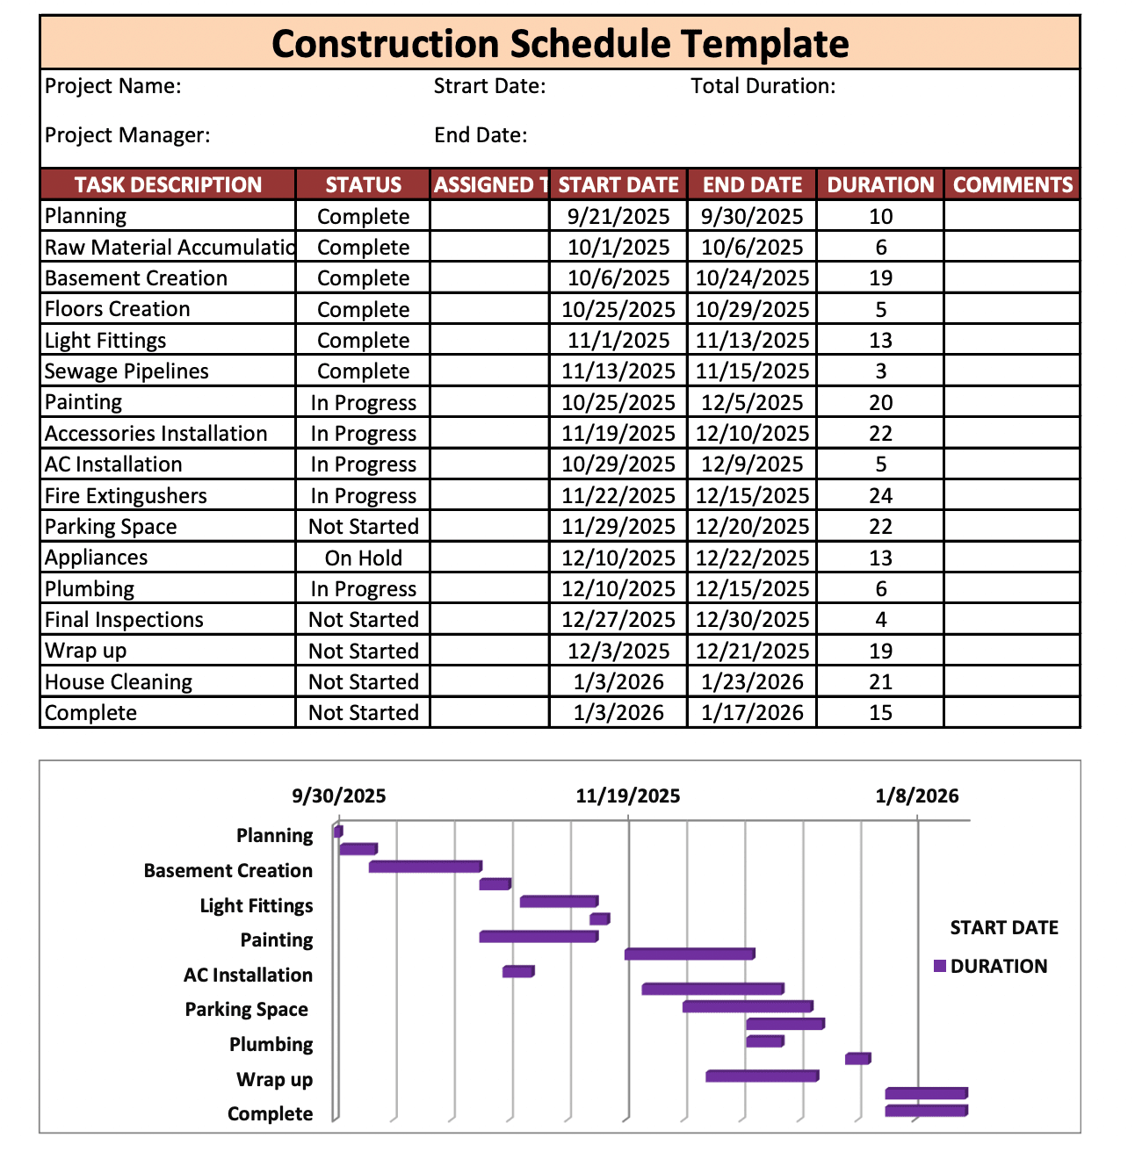
Construction Timeline Example #2
Notes:
Here is another example, that also allows for the entity to track dates easily.

Slide 28
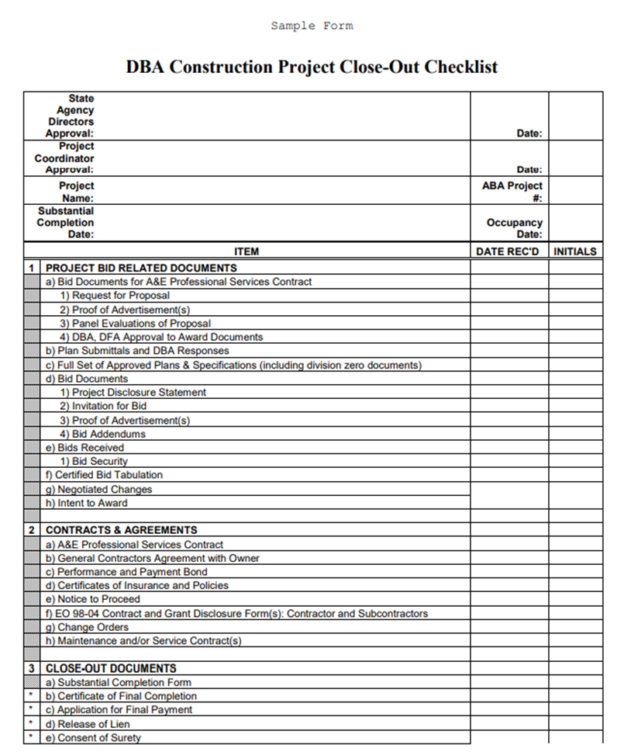
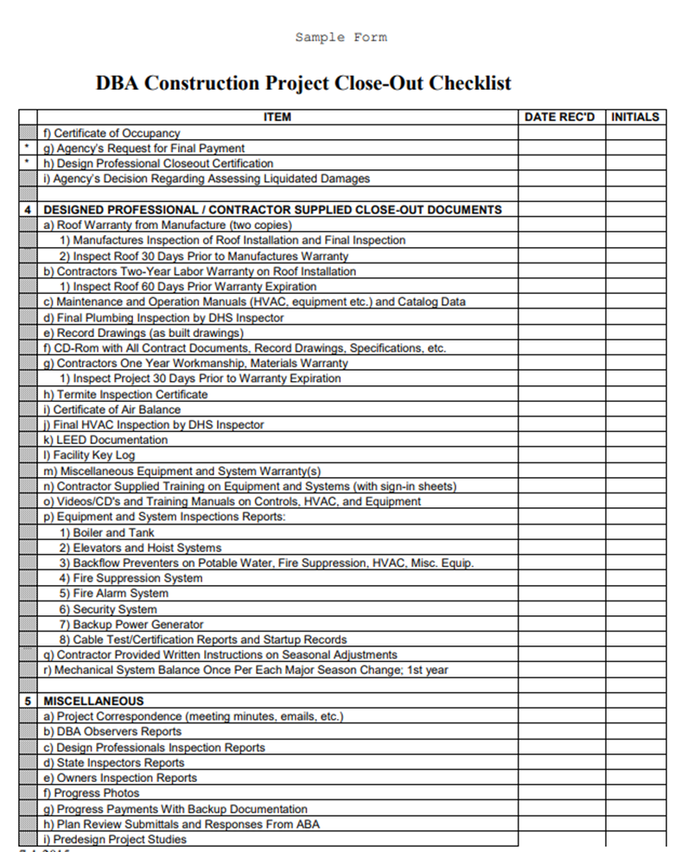
Construction Checklist Example #1
Notes:
Lastly, here is a construction checklist example that allows for the entity or general contractor to mark off as various aspects of the project are completed.

Slide 29
Local Building Departments
Below are a handful of local building departments that have information on permits, building requirements, and safety. This is a non-exhaustive list, and you may have to follow other building requirements not included below. Your contractor should oversee this process.
Las Vegas - https://www.lasvegasnevada.gov/Business/Permits-Licenses/Building-Permits
Clark County - https://www.clarkcountynv.gov/government/departments/building___fire_prevention/index.php
Reno - https://www.reno.gov/government/departments/development-services/building-permits
Washoe County - https://www.washoecounty.gov/building/
Carson City - https://www.carson.org/government/departments-a-f/community-development/building-division
Mineral County - http://mineralcountynv.us/departments/building_inspector.php
White Pine County - https://www.whitepinecounty.net/132/Building
Ely - https://www.cityofelynv.gov/building-department-and-building-codes-city-of-ely/
Lyon County - https://www.lyon-county.org/153/Building
Fernley - https://www.cityoffernley.org/74/Building-Department
Storey County - https://www.storeycounty.org/government/departments/community_development_building___fire_prevention/index.php
Douglas County - https://www.douglascountynv.gov/government/departments/community_development/building_division
Notes:
Localities also likely have requirements on safety, permitting, and construction that a project will need to follow. For your convenience, we have listed the major county and city building department websites.

Slide 30
References
Reference Documents
ARPA State and Local Fiscal Recovery Funds (SLFRF) Final Rule - https://home.treasury.gov/system/files/136/SLFRF-Final-Rule.pdf
Overview of the Final Rule - https://home.treasury.gov/system/files/136/SLFRF-Final-Rule-Overview.pdf
Final Rule FAQs - https://home.treasury.gov/system/files/136/SLFRF-Final-Rule-FAQ.pdf
SLFRF Compliance and Reporting Guidance - https://home.treasury.gov/system/files/136/SLFRF-Compliance-and-Reporting-Guidance.pdf
Recovery Plan Template - https://home.treasury.gov/system/files/136/SLFRF-Recovery-Plan-Performance-Report-Template.docx
Code of Federal Regulations over Grants (2 CFR 200) - https://www.ecfr.gov/current/title-2/subtitle-A/chapter-II/part-200?toc=1
Nevada Revised Statutes (NRS) 338 - https://www.leg.state.nv.us/nrs/nrs-338.html
State Administrative Manual (SAM) - https://budget.nv.gov/uploadedFiles/budgetnvgov/content/Governance/SAM.pdf
Nevada Administrative Code (NAC) 333 - https://www.leg.state.nv.us/nac/nac-333.html
Prevailing Wages
Nevada Labor Commissioner homepage - https://labor.nv.gov/PrevailingWage/2022-2023_Prevailing_Wages/)
2023 Clark County Prevailing Wage Rates - https://labor.nv.gov/uploadedFiles/labornvgov/content/PrevailingWage/1.%20CLARK%202023(4).pdf
2023 Southern Nevada Rural Counties Prevailing Wage Rates - https://labor.nv.gov/uploadedFiles/labornvgov/content/PrevailingWage/2.%20Southern%20Nevada%20Rural%20Region%202023(4).pdf
2023 Washoe county Prevailing Wage Rates - https://labor.nv.gov/uploadedFiles/labornvgov/content/PrevailingWage/3.%20Washoe%202023(4).pdf
2023 Northern Nevada Rural Counties Prevailing Wage rates - https://labor.nv.gov/uploadedFiles/labornvgov/content/PrevailingWage/4.%20Northern%20Nevada%20Rural%20Region%202023(3).pdf
Federal Prevailing wage (Davis-Bacon) Homepage - https://www.dol.gov/agencies/whd/government-contracts/construction
Nevada Dais-Bacon Search Results – https://sam.gov or https://bit.ly/3TXxXkG
Notes:
Here are the links and urls for the references used in this presentation.

Slide 31
References, contd.
Debarred Companies
Federal Law: https://www.ecfr.gov/current/title-48/chapter-1/subchapter-B/part-9/subpart-9.4
Federal Debarred Company Search Instruction: https://www.dol.gov/agencies/ofccp/debarred-list
Federal Debarred List: https://sam.gov/search/
Nevada Debarred List:
https://labor.nv.gov/PrevailingWage/Disqualified_Contractors/

Slide 32
Any questions?
Type any questions in the chat or use the Raise Hand feature.
Questions can also be emailed to covid19@finance.nv.gov. All questions received will be compiled into a FAQ document to be posted on the GFO website and emailed to attendees.

Slide 33
Contact Information
Email questions to covid19@finance.nv.gov
Use the subject line Capital Project Question
For urgent matters, contact your state cognizant agency

